Slide 1

Novia Retail Strategic Sales Insights
Executive Summary & Recommendations
3rd May, 2025

Slide 2
EXECUTIVE SUMMARY
Novia Retail achieved ₦10.27M in profit and ₦10.35M in revenue, with an average profit of ₦14.68K per transaction. The Government segment led profitability at ₦4.31M, while Paseo, Travesía, and VTT were the top-performing products. Enugu, Jos, and Abia emerged as the most profitable states. Online sales contributed the largest revenue share (35.53%), highlighting strong digital performance. Sales peaked in January and September, with dips in March and October. Strategic focus should be placed on high-margin segments, digital growth, and improving performance in key markets like Lagos and Abuja.

Slide 3
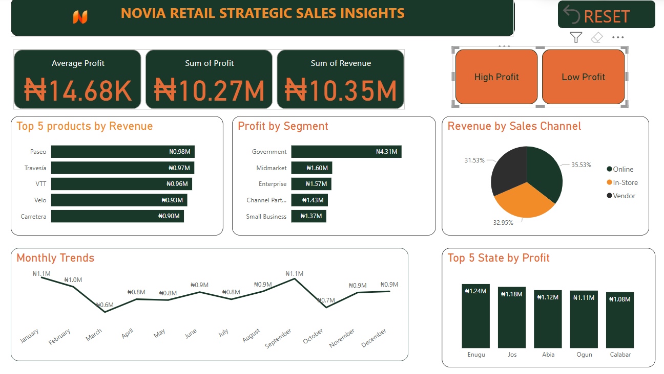

Slide 4
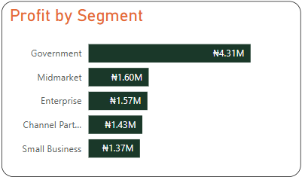
KEY FINDINGS: 1
High revenue/profit in main segment; Government & Midmarket are top performers by #4.31M and #1.60M respectively. However, low revenue was recorded in small business segment:

Slide 5
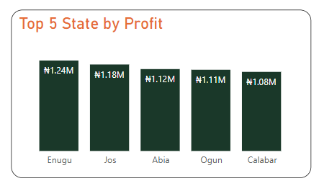
KEY FINDINGS: 2
Top 5 States with profit are;
Enugu - N1,120,126.50
Jos - N1,183,076.50
Ogun - N1,110,933.00
Abia – N1,120,126.50
Calabar - N1,081,867.50

Slide 6
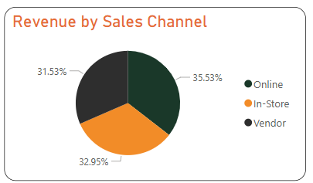
KEY FINDINGS: 3
Novia Retail has 3 major channels for sales drive. Online channel has the highest revenue percentage (35.5%), while in-store, and vendor channels share similar revenue percentages.

Slide 7
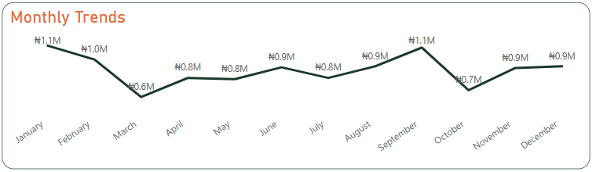
KEY FINDINGS: 4
Peak value was recorded in January (N1,109,648.00), and in September(N1,090,480.50). With lowest value recorded in March (N593,473.00).

Slide 8
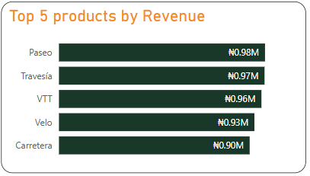
KEY FINDINGS: 5
Novia retail recorded Paseo as the most sold product with a revenue of (0.98m). The top5 products are;
Paeso (N975,728.50)
Travesia (N973,442.00)
VTT (N958,734.00)
Velo (N925,538.50)
Carretera (N903,051.00)

Slide 9
Recommendations to the Business
Prioritize Government & Midmarket segments with tailored strategies.
Reevaluate or discontinue low-performing products.
Introduce promotions in low-sales months (March, April, November).
Optimize underperforming sales channels for better conversion.
Boost marketing in high-profit states and uplift low-performing regions like Lagos and Kano.

Slide 10
Conclusion
Novia Bank's retail performance shows strong areas of opportunity in government & midmarket segments, with room for growth in low-profit products and regions. Strategic focus on product, channel, and regional performance can drive sustained profitability.

